Slide 1
Fundamentals
Linux Process Execution
Yan Shoshitaishvili
Arizona State University

Slide 2
/bin/cat

Slide 3
cat /flag
A process is created.
Cat is loaded.
Cat is initialized.
Cat is launched.
Cat reads its arguments and environment.
Cat does its thing.
Cat terminates.

Slide 4
cat /flag
A process is created.
Cat is loaded.
Cat is initialized.
Cat is launched.
Cat reads its arguments and environment.
Cat does its thing.
Cat terminates.

Slide 5
Cat is launched.
A normal ELF automatically calls __libc_start_main() in libc, which in turn calls the program's main() function.
Your code is running!
Now what?

Slide 6
cat /flag
A process is created.
Cat is loaded.
Cat is initialized.
Cat is launched.
Cat reads its arguments and environment.
Cat does its thing.
Cat terminates.

Slide 7
Cat reads its arguments and environment.
int main(int argc, void **argv, void **envp);
Your process's entire input from the outside world, at launch, comprises of:
the loaded objects (binaries and libraries)
command-line arguments in argv
"environment" in envp
Of course, processes need to keep interacting with the outside world.

Slide 8
cat /flag
A process is created.
Cat is loaded.
Cat is initialized.
Cat is launched.
Cat reads its arguments and environment.
Cat does its thing.
Cat terminates.

Slide 9
Using library functions
The binary's import symbols have to be resolved using the libraries' export symbols.
In the past, this was an on-demand process and carried great peril.
In modern times, this is all done when the binary is loaded, and is much safer.
We'll explore this further in the future.

Slide 10
Interacting with the environment
Almost all programs have to interact with the outside world!
This is primarily done via system calls (man syscalls). Each system call is well-documented in section 2 of the man pages (i.e., man 2 open).
We can trace process system calls using strace.

Slide 11
System Calls
System calls have very well-defined interfaces that very rarely change.
There are over 300 system calls in Linux. Here are some examples:
int open(const char *pathname, int flags) - returns a file new file descriptor of the open file (also shows up in /proc/self/fd!)
ssize_t read(int fd, void *buf, size_t count) - reads data from the file descriptor
ssize_t write(int fd, void *buf, size_t count) - writes data to the file descriptor
pid_t fork() - forks off an identical child process. Returns 0 if you're the child and the PID of the child if you're the parent.
int execve(const char *filename, char **argv, char **envp) - replaces your process.
pid_t wait(int *wstatus) - wait child termination, return its PID, write its status into *wstatus.
long syscall(long syscall, ...) - invoke specified syscall.
Typical signal combinations:
fork, execve, wait (think: a shell)
open, read, write (cat)

Slide 12
Signals
System calls are a way for a process to call into the OS. What about the other way around?
Enter: signals. Relevant system calls:
sighandler_t signal(int signum, sighandler_t handler) - register a signal handler
int sigaction(int signum, const struct sigaction *act, struct sigaction *oldact) - more modern way of registering a signal handler
int kill(pid_t pid, int sig) - send a signal to a process.
Signals pause process execution and invoke the handler.
Handlers are functions that take one argument: the signal number.
Without a handler for a signal, the default action is used (often, kill).
SIGKILL (signal 9) and SIGSTOP (signal 19) cannot be handled.

Slide 13
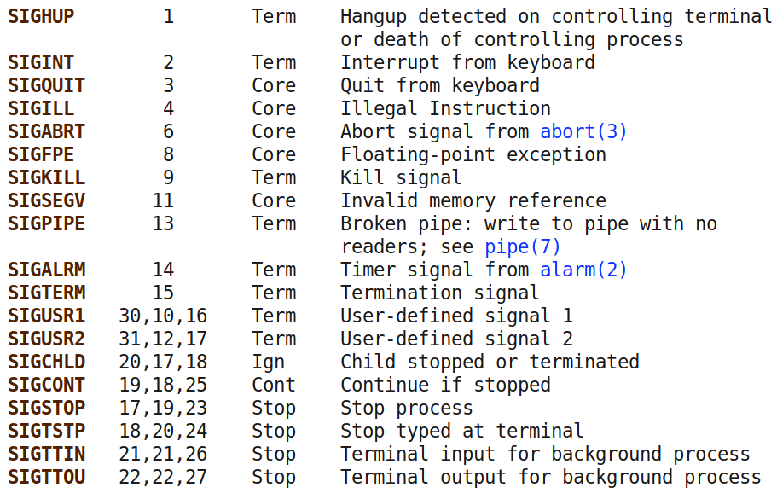
Signals
Full list in section 7 of man (man 7 signal) and kill -l. Common signals:

Slide 14
Shared memory
Another way of interacting with the outside world is by sharing memory with other processes.
Requires system calls to establish, but once established, communication happens without system calls.
Easy way: use a shared memory-mapped file in /dev/shm.

Slide 15
cat /flag
A process is created.
Cat is loaded.
Cat is initialized.
Cat is launched.
Cat reads its arguments and environment.
Cat does its thing.
Cat terminates.

Slide 16
Process termination
Processes terminate by one of two ways:
Receiving an unhandled signal.
Calling the exit() system call: int exit(int status)
All processes must be "reaped":
after termination, they will remain in a zombie state until they are wait()ed on by their parent.
When this happens, their exit code will be returned to the parent, and the process will be freed.
If their parent dies without wait()ing on them, they are re-parented to PID 1 and will stay there until they're cleaned up.

Slide 17
cat /flag
A process is created.
Cat is loaded.
Cat is initialized.
Cat is launched.
Cat reads its arguments and environment.
Cat does its thing.
Cat terminates.

